Slide 1

The First Week
Work Conclusion
THE Week WORK SUMMARY REPORT
Reporter：Zhang Meng xi

Slide 2
Work Step
PART 01
PART 02
PART 03
PART 04
PART 05
Download Data
Improve Code
Import Data to
database
Study CSV File
The Next Week
Work

Slide 3
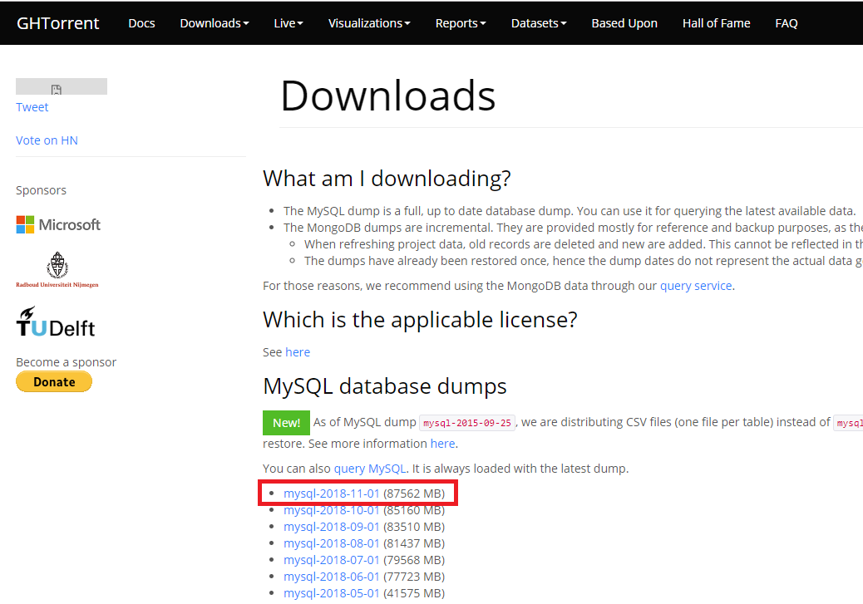
Download Data
PART 01
I downloaded the data of GHTorrent, which contains all the data on GitHub. It is composed of many CSV files, and the extracted data is about 300G.
As shown in the picture, I downloaded mysql-2018-11-01, the latest database for research.

Slide 4
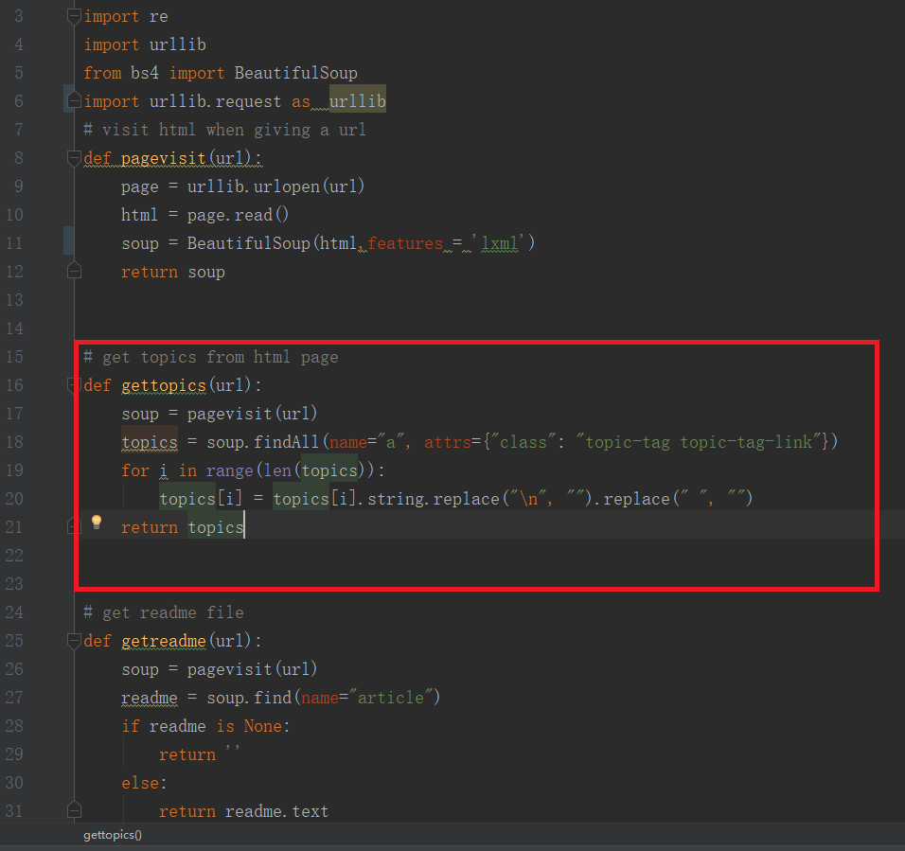
Improve Code
PART 02
When I download the GHTorrent Data, I added the function to the original code. As well as the code itself, the function argument is the URL of the GitHub page, and the output is the topic for that page.

Slide 5
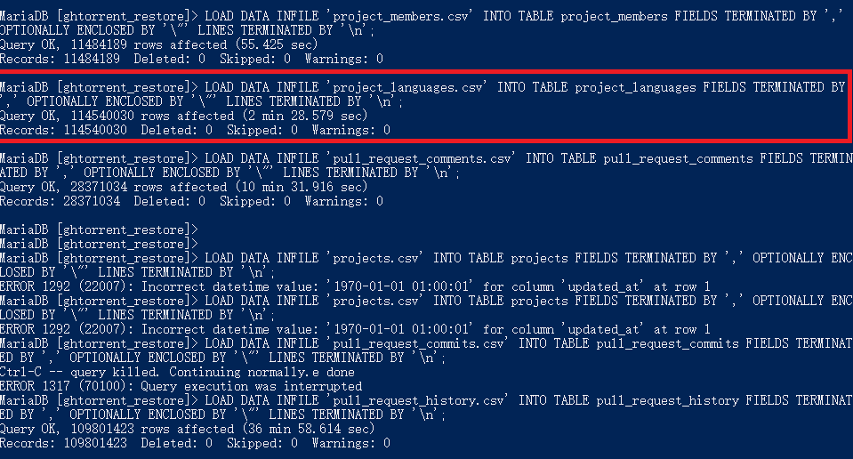
Import Data to
database
PART 03
After downloading the data, I need to import these data to
MySQL DataBase。Then I follow
the readme documentation to import the data to database.

Slide 6
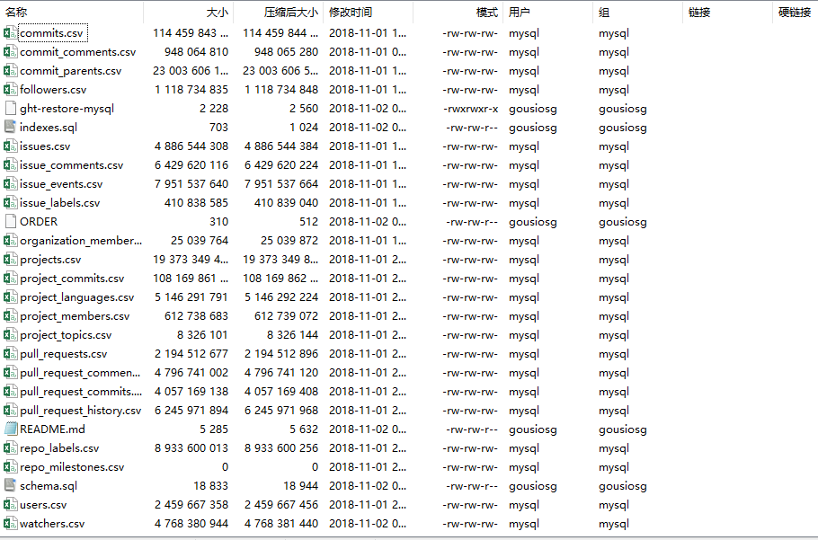
Study the CSV Files
PART 04
The GHTorrent data contains 22 csv
files. And when I import these data to the MySQL database, I study the What these documents represent.

